Slide 1
Lab 05 TCP
Network programming
Human-centered AI(휴먼지능정보공학전공)
201910783
Kim Seong Hyun(김성현)

Slide 2
Instructions
Start up your web browser. Go the http://gaia.cs.umass.edu/wiresharklabs/alice.txt and retrieve an ASCII copy of Alice in Wonderland. Store this file somewhere on your computer.
Next go to http://gaia.cs.umass.edu/wireshark-labs/TCP-wireshark-file1.html.
Use the ‘Browse’ button to enter the name of the file (full path name) on your computer containing Alice in Wonderland (or do so manually). Don’t yet press the “Upload alice.txt file” button.
Now start up Wireshark and begin packet capture (Capture->Start) and then press OK on the Wireshark Packet Capture Options screen (we’ll not need to select any options here).
Returning to your browser, press the “Upload alice.txt file” button to upload the file to the gaia.cs.umass.edu server. Once the file has been uploaded, a short congratulations message will be displayed in your browser window.
Stop Wireshark packet capture.
Filter the packets displayed in the Wireshark window by entering “tcp” (lowercase)

Slide 3
Question part 1

Slide 4
Questions (Part 1/5)
What is the IP address and TCP port number used by the client computer (source) that is transferring the file to gaia.cs.umass.edu?
What is the IP address of gaia.cs.umass.edu? On what port number is it sending and receiving TCP segments for this connection?

Slide 5
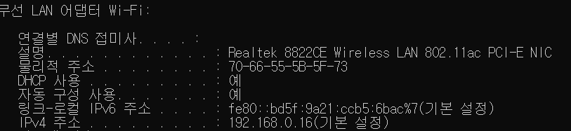
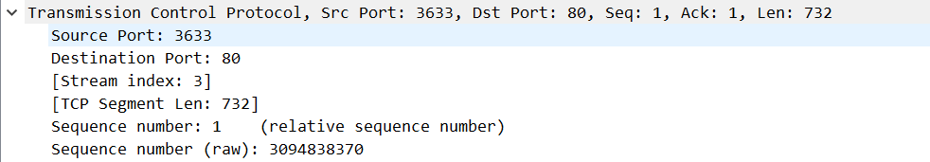
1. What is the IP address and TCP port number used by the client computer (source) that is transferring the file to gaia.cs.umass.edu?
IP address(source): 192.168.0.16
TCP port number(source): 3633

Slide 6
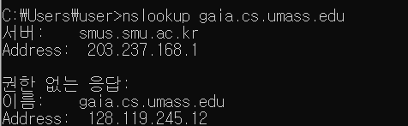
2. What is the IP address of gaia.cs.umass.edu? On what port number is it sending and receiving TCP segments for this connection?
IP address(gaia.cs.umass.edu): 128.119.245.12
TCP segment port number: 80

Slide 7
Question part 2

Slide 8

Questions (Part 2/5)
What is the sequence number of the TCP SYN segment that is used to initiate the TCP connection between the client computer and gaia.cs.umass.edu? What is it in the segment that identifies the segment as a SYN segment?
What is the sequence number of the SYNACK segment sent by gaia.cs.umass.edu to the client computer in reply to the SYN? What is the value of the Acknowledgement field in the SYNACK segment? How did gaia.cs.umass.edu determine that value? What is it in the segment that identifies the segment as a SYNACK segment?
What is the sequence number of the TCP segment containing the HTTP POST command? Note that in order to find the POST command, you’ll need to dig into the packet content field at the bottom of the Wireshark window, looking for a segment with a “POST” within its DATA field.

Slide 9
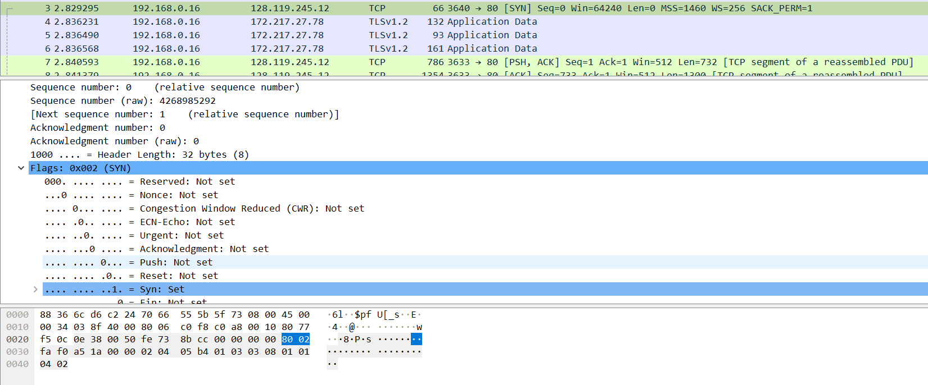
1. What is the sequence number of the TCP SYN segment that is used to initiate the TCP connection between the client computer and gaia.cs.umass.edu? What is it in the segment that identifies the segment as a SYN segment?

Slide 10
1. What is the sequence number of the TCP SYN segment that is used to initiate the TCP connection between the client computer and gaia.cs.umass.edu? What is it in the segment that identifies the segment as a SYN segment?
SYN segment: client computer와 gaia.cs.umass.edu 사이의 TCP 연결을 모방하는데 사용, 즉 TCP 연결의 첫 시작에 사용된다. ➔ sequence number = 0을 의미한다.
앞 장에 있는 그림에 따르면, Flag Section에서 Syn flag는 1로 설정되며, 이는 이 segment가 SYN segment임을 나타낸다.

Slide 11
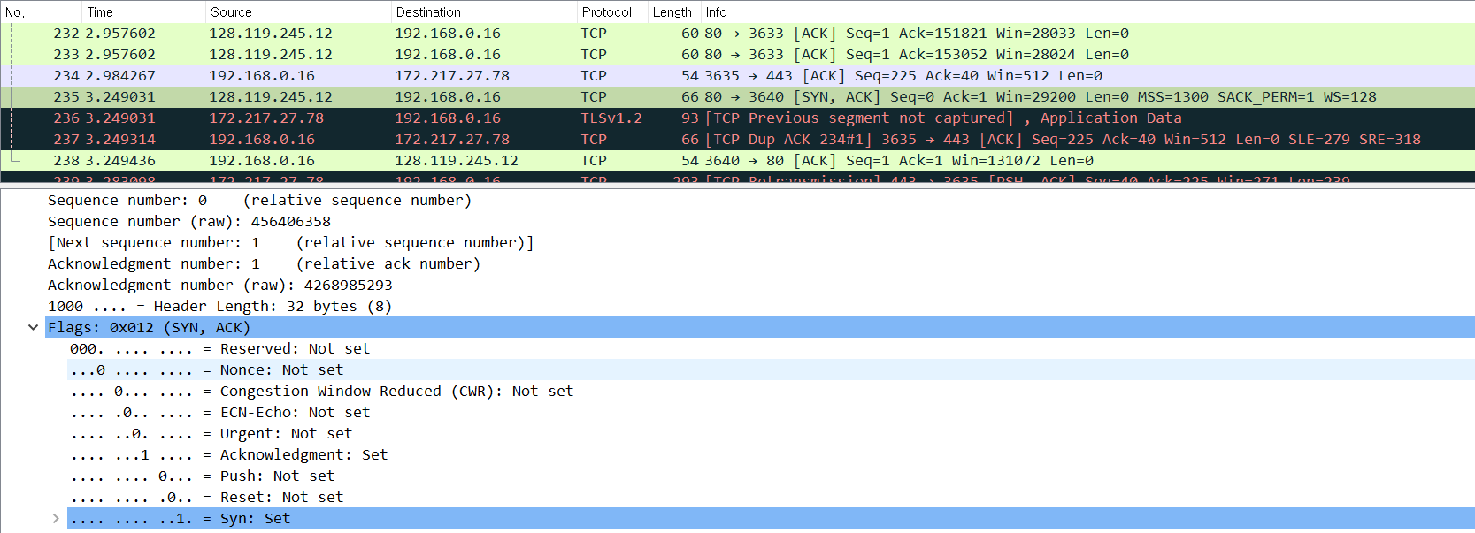
2. What is the sequence number of the SYNACK segment sent by gaia.cs.umass.edu to the client computer in reply to the SYN? What is the value of the Acknowledgement field in the SYNACK segment? How did gaia.cs.umass.edu determine that value? What is it in the segment that identifies the segment as a SYNACK segment?
SYNACK segment ➔ gaia.cs.umass.edu가 SYN에 응답하여 client 컴퓨터로 전송하는 segment. Sequence number = 0.
SYNACK segment에서 Acknowledgement field의 값 = 1. 이 값은 서버 gaia.cs.umass.edu.에 의해 결정된다.
서버는 client 컴퓨터에서 SYN segment의 초기 sequence number에 1을 추가. 이 경우 client 컴퓨터에서 SYN segmen의 초기 sequence numbe가 0이므로 SYNACK segmen에서 Acknowledgement field의 값은 1이다.
Segment에서 SYN flag와 Acknowledgment를 모두 1로 설정하면 segmen가 SYNACK sgement로 식별되기에 1인 것이다.

Slide 12
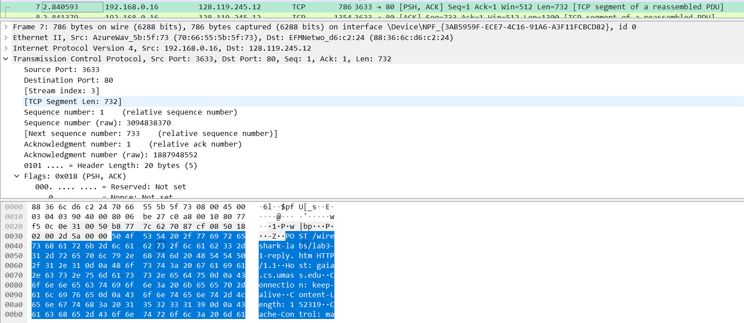
3. What is the sequence number of the TCP segment containing the HTTP POST command? Note that in order to find the POST command, you’ll need to dig into the packet content field at the bottom of the Wireshark window, looking for a segment with a “POST” within its DATA field.
HTTP POST command(80)이 포함된 TCP segmen의 sequence number = 1.
DATA field에 “POST”라고 sgement의 data에 포함되어 있다는 것을 볼 수 있다.

Slide 13
Question part 3

Slide 14
Questions (Part 3/5)
Consider the TCP segment containing the HTTP POST as the first segment in the TCP connection.
What are the sequence numbers of the first six segments in the TCP connection (including the segment containing the HTTP POST)?
At what time was each segment sent? When was the ACK for each segment received?
Given the difference between when each TCP segment was sent, and when its acknowledgement was received, what is the RTT value for each of the six segments?
Note: Wireshark has a nice feature that allows you to plot the RTT for each of the TCP segments sent. Select a TCP segment in the “listing of captured packets” window that is being sent from the client to the gaia.cs.umass.edu server. Then select: Statistics->TCP Stream Graph->Round Trip Time Graph.

Slide 15
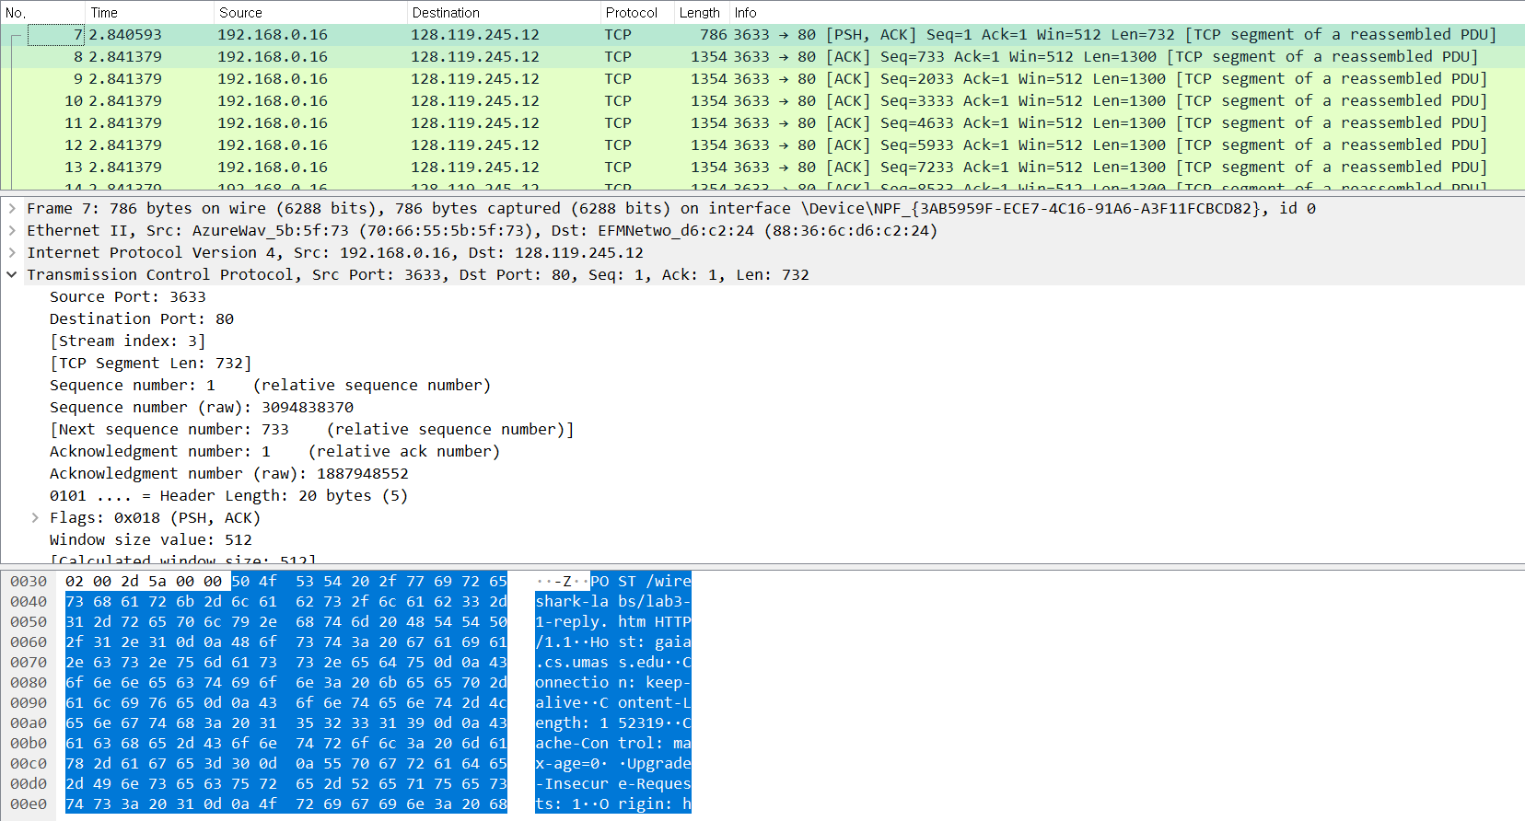
1. What are the sequence numbers of the first six segments in the TCP connection (including the segment containing the HTTP POST)?
➔ first six segments in the TCP connection: 7, 8, 9, 10, 11, 12번.

Slide 16
1. What are the sequence numbers of the first six segments in the TCP connection (including the segment containing the HTTP POST)?
Sequence numbers:
7번(first segment) = 1,
8번(second segment) = 733,
9번(third segment) = 2033,
10번(fourth segment) = 3333,
11번(fixth segment) = 4633,
12번(sixth segment) = 5933.

Slide 17
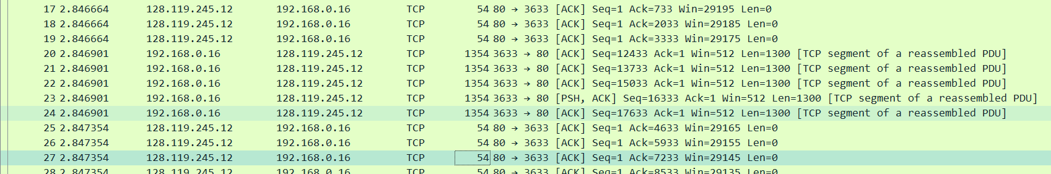
2. At what time was each segment sent? When was the ACK for each segment received?
segment | Sent time | ACK received | RTT
First segment | 2.840593 | 2.846664 | 0.006071
Second segment | 2.841379 | 2.846664 | 0.005285
Third segment | 2.841379 | 2.846664 | 0.005285
Fourth segment | 2.841379 | 2.847354 | 0.005975
Fixth segment | 2.841379 | 2.847354 | 0.005975
Sixth segment | 2.841379 | 2.847354 | 0.005975

Slide 18
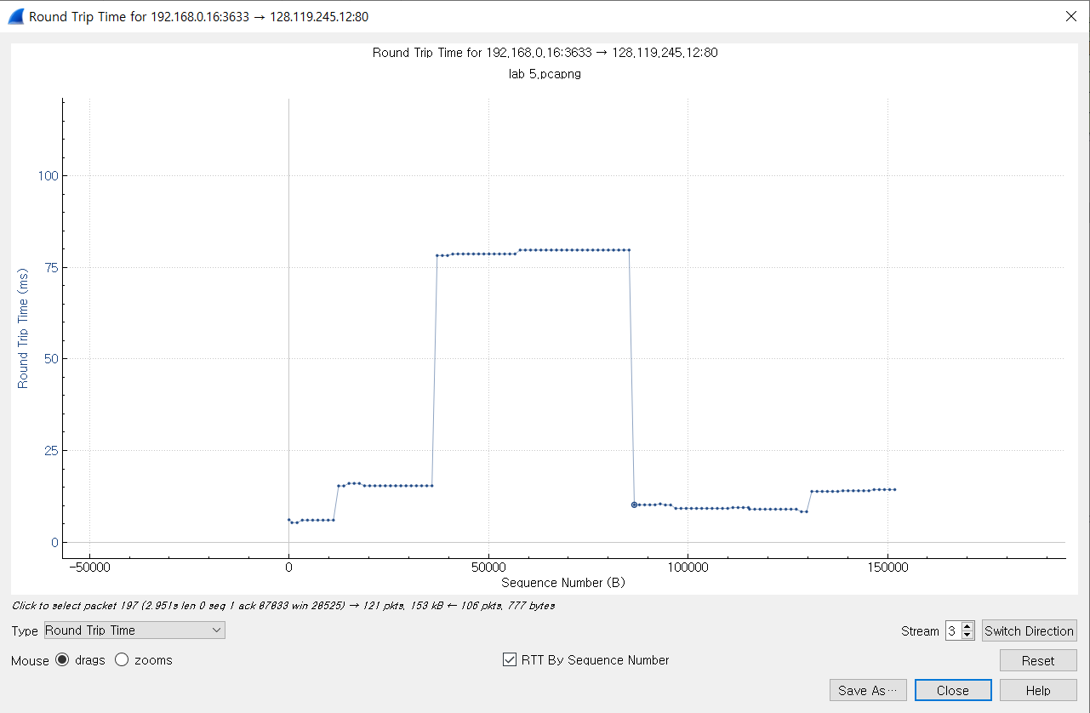
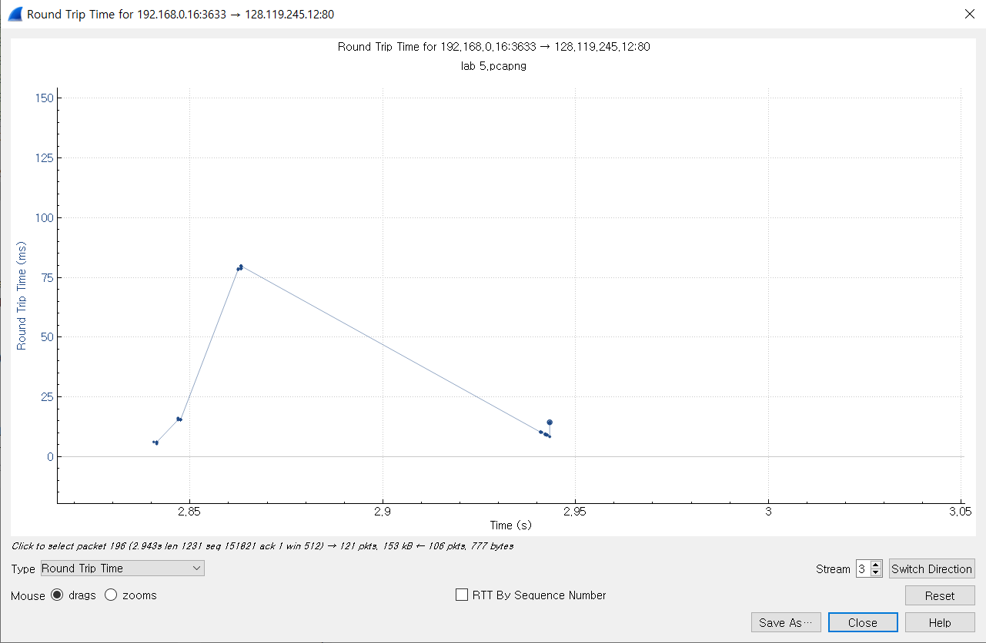
3. Given the difference between when each TCP segment was sent, and when its acknowledgement was received, what is the RTT value for each of the six segments? Note: Wireshark has a nice feature that allows you to plot the RTT for each of the TCP segments sent. Select a TCP segment in the “listing of captured packets” window that is being sent from the client to the gaia.cs.umass.edu server. Then select: Statistics->TCP Stream Graph->Round Trip Time Graph.
segment | Sent time | ACK received | RTT
7번 | 2.840593 | 2.846664 (17번) | 0.006071
8번 | 2.841379 | 2.846664 (18번) | 0.005285
9번 | 2.841379 | 2.846664 (19번) | 0.005285
10번 | 2.841379 | 2.847354 (25번) | 0.005975
11번 | 2.841379 | 2.847354 (26번) | 0.005975
12번 | 2.841379 | 2.847354 (27번) | 0.005975

Slide 19
Question part 4

Slide 20
Questions (Part 4/5)
What is the length of each of the first six TCP segments?
What is the minimum amount of available buffer space advertised at the received for the entire trace? Does the lack of receiver buffer space ever throttle(차단 혹은 전송 rate 감소) the sender?
Are there any retransmitted segments in the trace file? What did you check for (in the trace) in order to answer this question?
How much data does the receiver typically acknowledge in an ACK? Can you identify cases where the receiver is ACKing every other received segment (see the table on next page).
What is the throughput (bytes transferred per unit time) for the TCP connection? Explain how you calculated this value.

Slide 21
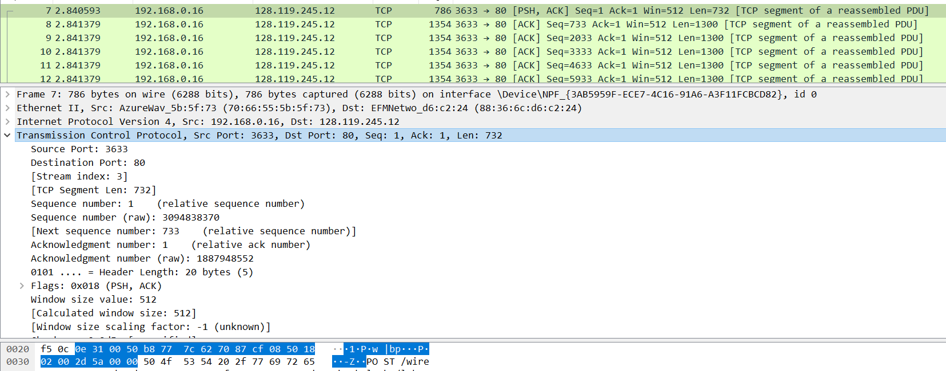

1. What is the length of each of the first six TCP segments?
➔ 7번(first segment): TCP Header(20) + Data(732) = 752
각각의 segment의 length는 TCP Header의 크기 + Data의 크기로 나타낼 수 있다.

Slide 22
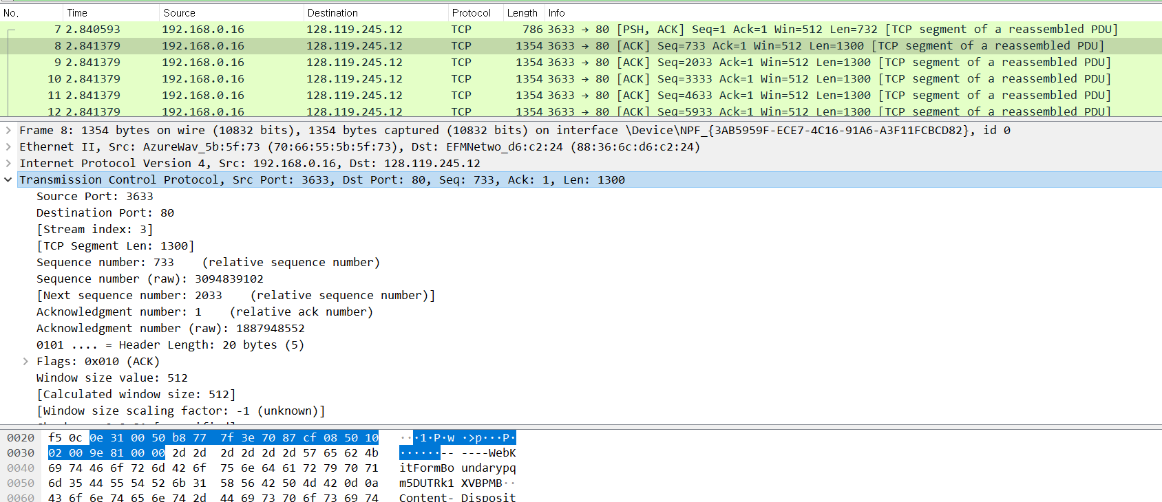

1. What is the length of each of the first six TCP segments?
➔ 8번(second segment): TCP Header(20) + Data(1300) = 1320
각각의 segment의 length는 TCP Header의 크기 + Data의 크기로 나타낼 수 있다.

Slide 23
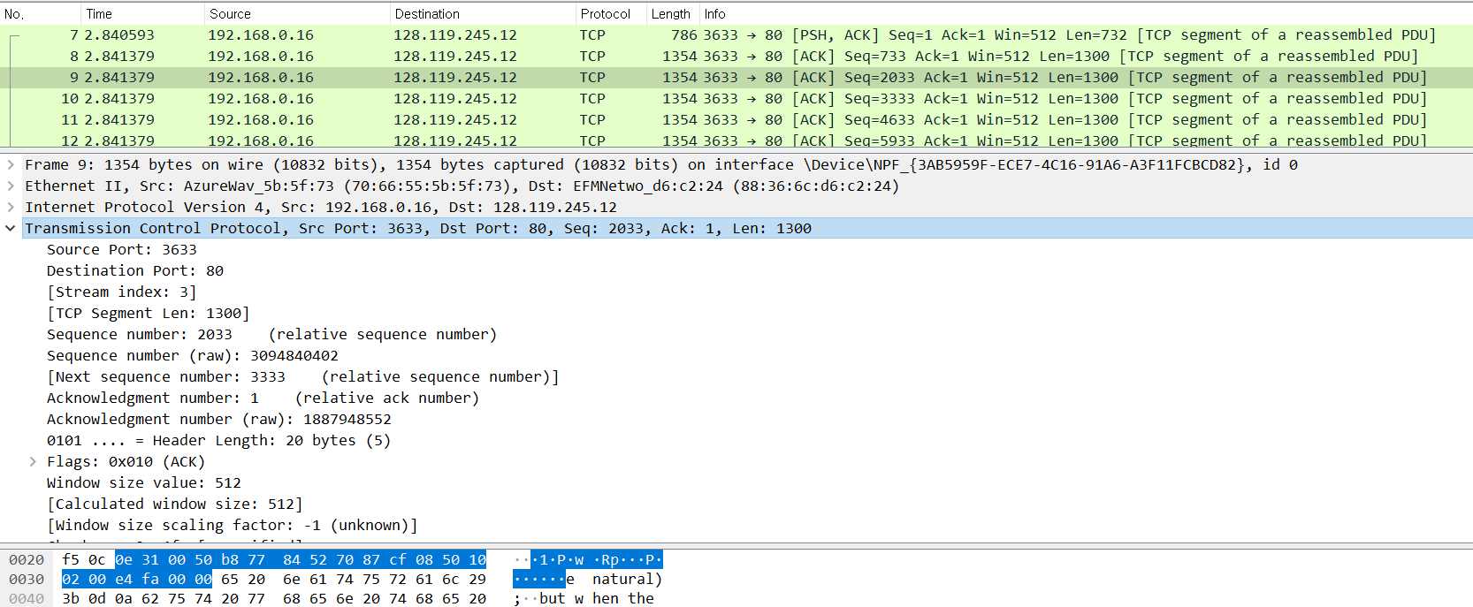

1. What is the length of each of the first six TCP segments?
➔ 9번(third segment): TCP Header(20) + Data(1300) = 1320
각각의 segment의 length는 TCP Header의 크기 + Data의 크기로 나타낼 수 있다.

Slide 24
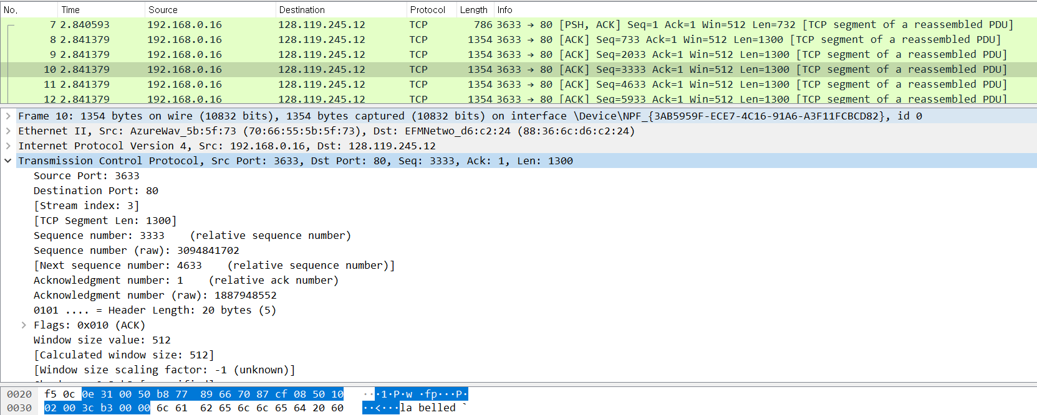

1. What is the length of each of the first six TCP segments?
➔ 10번(fourth segment): TCP Header(20) + Data(1300) = 1320
각각의 segment의 length는 TCP Header의 크기 + Data의 크기로 나타낼 수 있다.

Slide 25
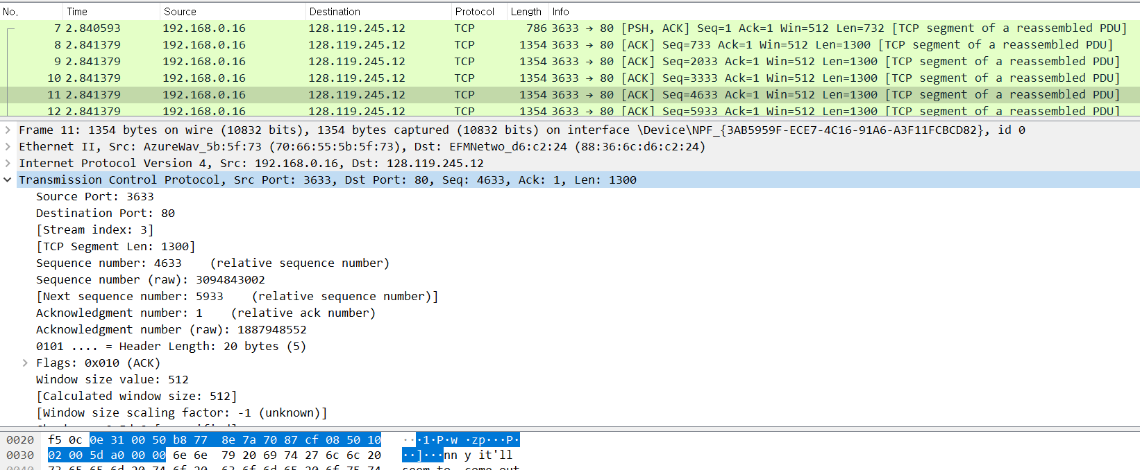

1. What is the length of each of the first six TCP segments?
➔ 11번(fixth segment): TCP Header(20) + Data(1300) = 1320
각각의 segment의 length는 TCP Header의 크기 + Data의 크기로 나타낼 수 있다.

Slide 26


1. What is the length of each of the first six TCP segments?
➔ 12번(sixth segment): TCP Header(20) + Data(1300) = 1320
각각의 segment의 length는 TCP Header의 크기 + Data의 크기로 나타낼 수 있다.

Slide 27
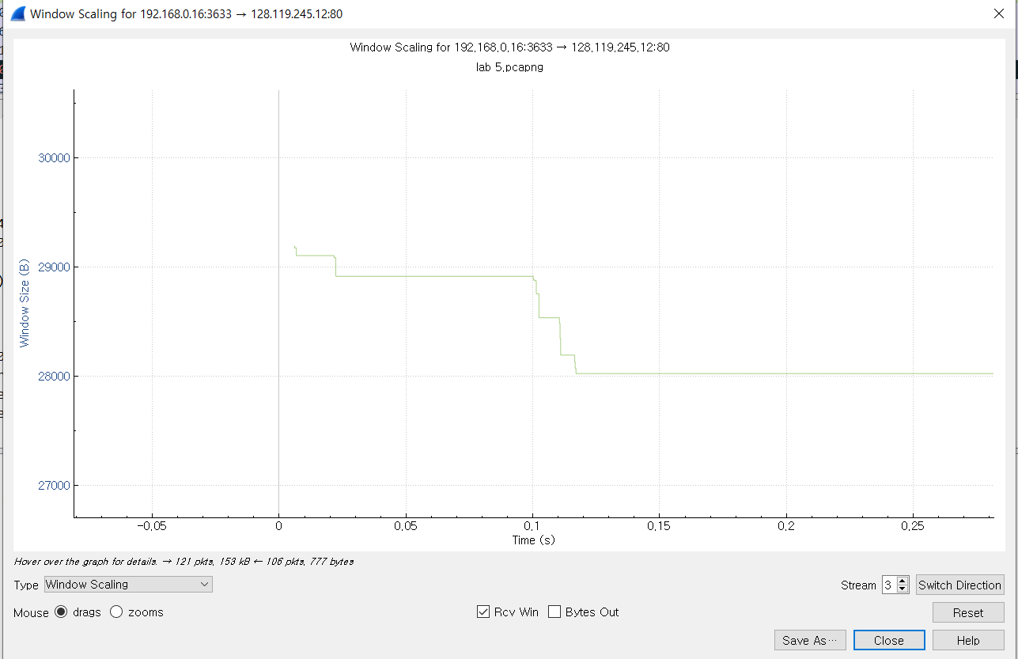
2. What is the minimum amount of available buffer space advertised at the received for the entire trace? Does the lack of receiver buffer space ever throttle(차단 혹은 전송 rate 감소) the sender?
→Entire trace에 대해 수신된 곳에서 advertised되는 minimum amount of available buffer space 값은 28000byte(위 그림 참조)이다.

Slide 28
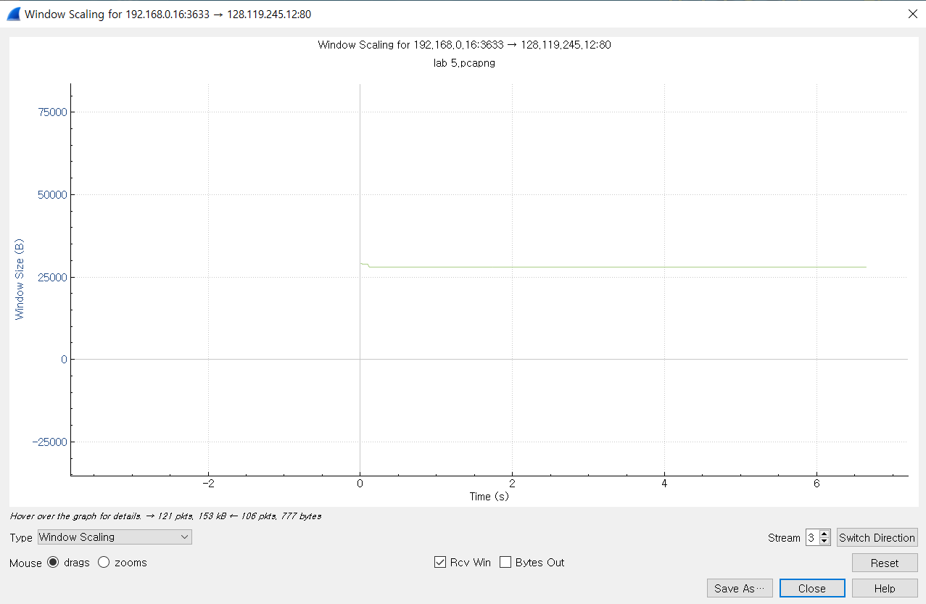
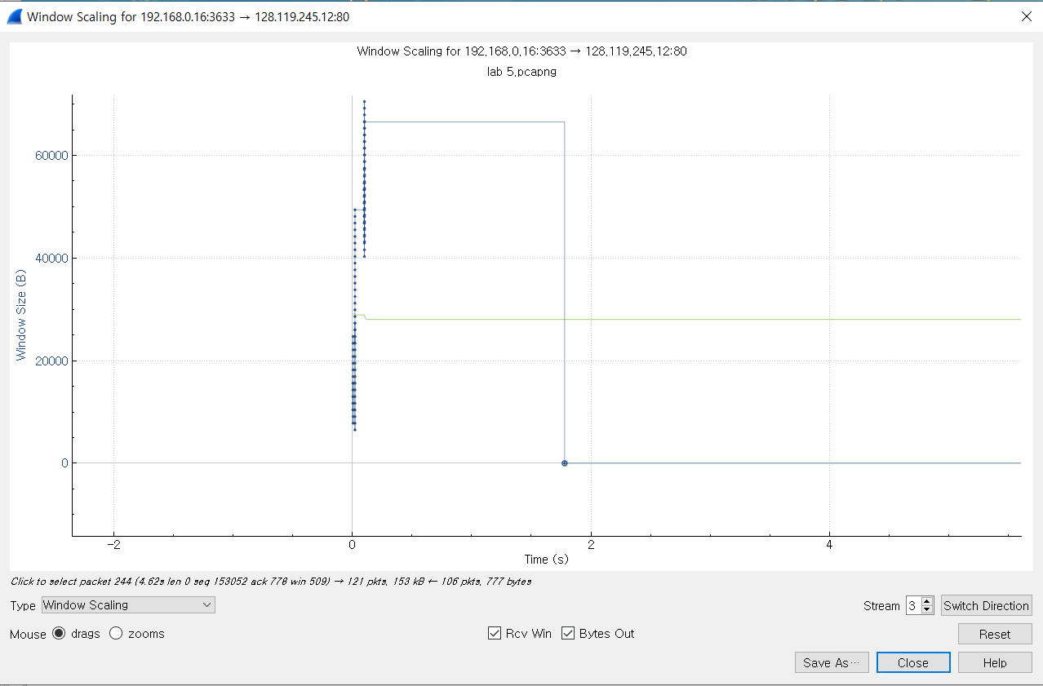
2. What is the minimum amount of available buffer space advertised at the received for the entire trace? Does the lack of receiver buffer space ever throttle(차단 혹은 전송 rate 감소) the sender?
→throttle, 즉 lack of recviver buffer space로 인한 넓었던 전송 범위가 줄어드는 현상을 우리는 여기서 목격할 수 있다. 또한 오른쪽 그림에서 줄어든 전송 범위로 인한 순간적인 byte out량의 감소 또한 목격할 수 있다.

Slide 29
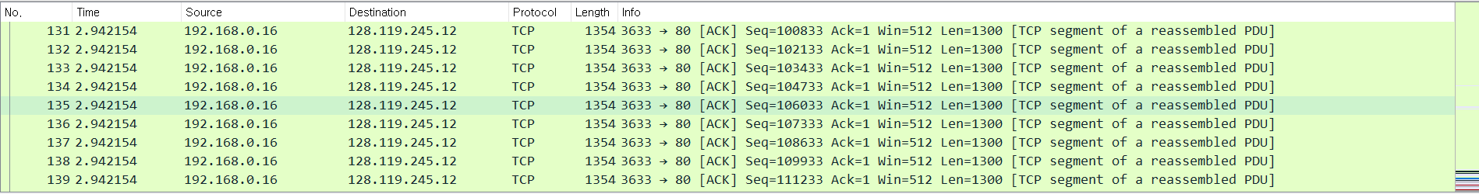
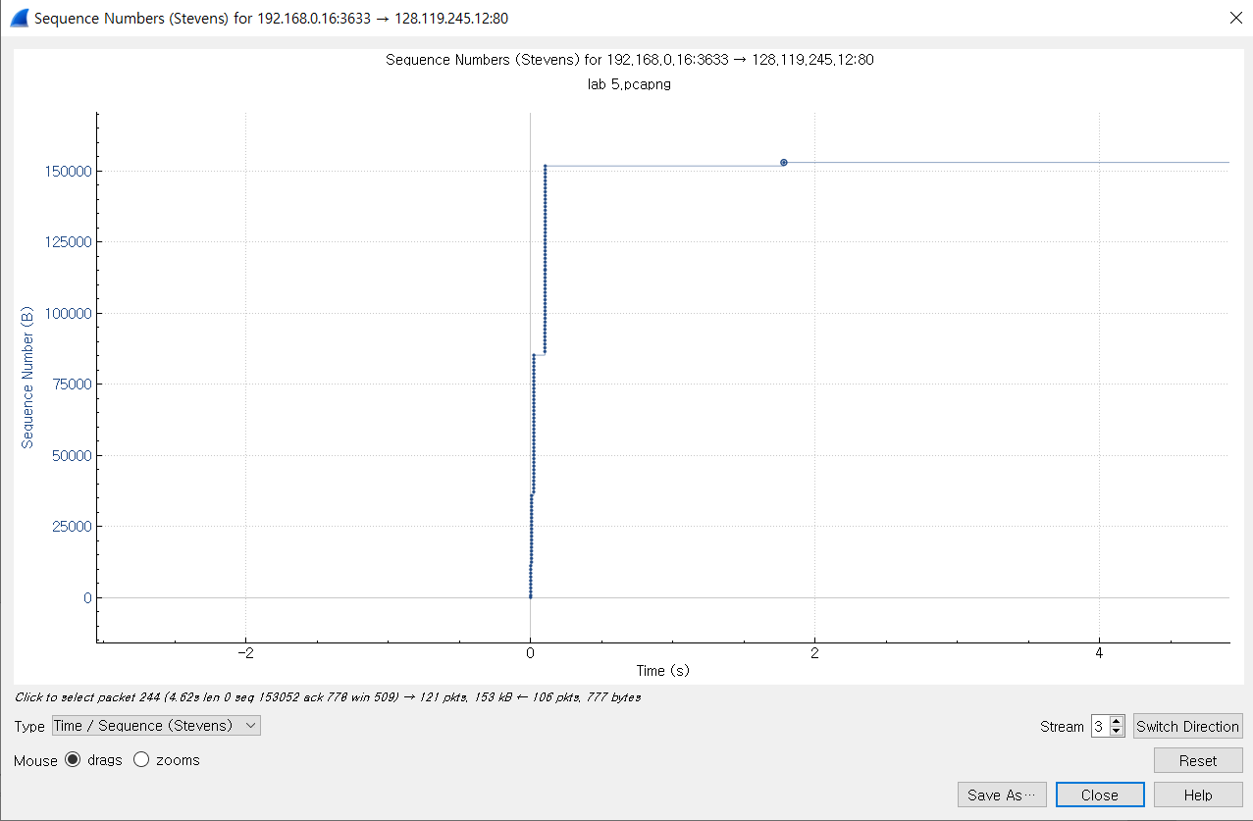
3. Are there any retransmitted segments in the trace file? What did you check for (in the trace) in order to answer this question?
본 capture trace file에서는 재전송된 segment가 없다라는 것을 우리는 위 graph를 통해 알 수 있다.
재전송이 이뤄지면 sequence number가 작아져야 하는데, graph를 보면 그러한 현상은 일어나지 않았다는 것을 볼 수 있다.
다만, gaia쪽 segment들을 벗어난 전체적인 trace를 보면 까만색 segment들이 보이기는 하기에 재전송 혹은 모종의 segment가 사라졌음을 우리는 또 볼 수 있다.

Slide 30
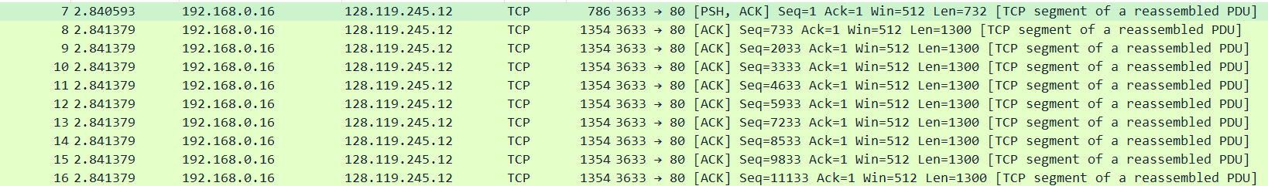
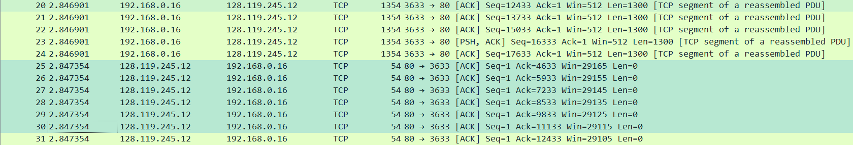
4. How much data does the receiver typically acknowledge in an ACK? Can you identify cases where the receiver is ACKing every other received segment (see the table on next page).
Sequence Number | Sequence Data | Ack Data | Ack Data 차이
17번 | ~732 | 733 | -
18번 | 733 ~ 2032 | 2033 | 1300
18번 | 2033 ~ 3332 | 3333 | 1300
25번 | 3333 ~ 4632 | 4633 | 1300
26번 | 4633 ~ 5932 | 5933 | 1300
27번 | 5933 ~ 7232 | 7233 | 1300

Slide 31
4. How much data does the receiver typically acknowledge in an ACK? Can you identify cases where the receiver is ACKing every other received segment (see the table on next page).
→ 연속된 ACK의 Data차이(Sequence Number의 차이)는 서버가 두 ACK 사이에서 수신한 Data를 의미.
17번에서 ACK가 733이고, 18번 ACK가 2033이므로 둘 사이의 수신한 Data의 크기는 ‘1300’이다.
→ 이 때, Receiver는 다른 Segment마다 ACKing인 경우를 식별할 수 있다. 즉, Receiver가 ACK에서 확인하는 Data 양은 1300 혹은 1300의 배수이다. 1300과 1300의 배수 둘 다 생각하는 이유는
현재로썬 매 ACK마다 data의 차이가 1300으로 계속 동일하게만 나오기 때문이다.
다만 복수의 ACK의 도착 시기가 같고 본 capture에서 wireshark가 일부러 분리시켜 보여준 것일수도, 분리되어 동시에 온 것일 수 있어
잡힌 wireshark packet 전체를 싹 다 파악한 것은 아니기에 1300 이상의 ACK data차를 아직까진 확인하지 못했다.

Slide 32
5. What is the throughput (bytes transferred per unit time) for the TCP connection? Explain how you calculated this value.
→총 Data의 양은 server의 마지막 ACK의 sequence number인 153052byte이다.
→총 전송 시간은 전송된 첫번째 TCP segment의 시간과 마지막으로 받은 ACK의 시간의 차이다. 즉, 마지막으로 받은 ACK의 시간인9.493982에서 첫번째 TCP segment의 시간인 2.840593sec을 뺀 6.653389sec이 총 전송 시간이다.
시간을 구할 때 3 way handshake는 전송되는 데이터가 없어서 포함하지 않는다.
Throughput(bytes transferred per unit time): 총 전송 시간에 대한 총 Data의 양의 비율
153057byte/ 6.653389sec = 23,004.36664683216 Byte/sec이다.

Slide 33
Question part 5

Slide 34
Lab activities & Question for TCP congestion control
Try to upload files with various sizes
Select a TCP segment in the Wireshark’s “listing of captured-packets” window. Then select the menu : Statistics->TCP Stream Graph-> Time-Sequence-Graph(Stevens).
Question: (Part 5/5)
Use the Time-Sequence-Graph(Stevens) plotting tool to view the sequence number versus time plot of segments being sent from the client to the gaia.cs.umass.edu server.
Can you identify where TCP’s slowstart phase begins and ends, and where congestion avoidance takes over? Comment on ways in which the measured data differs from the idealized behavior of TCP that we’ve studied in the text.
Answer the questions above for the trace that you have gathered when you transferred a file from your computer to gaia.cs.umass.edu

Slide 35
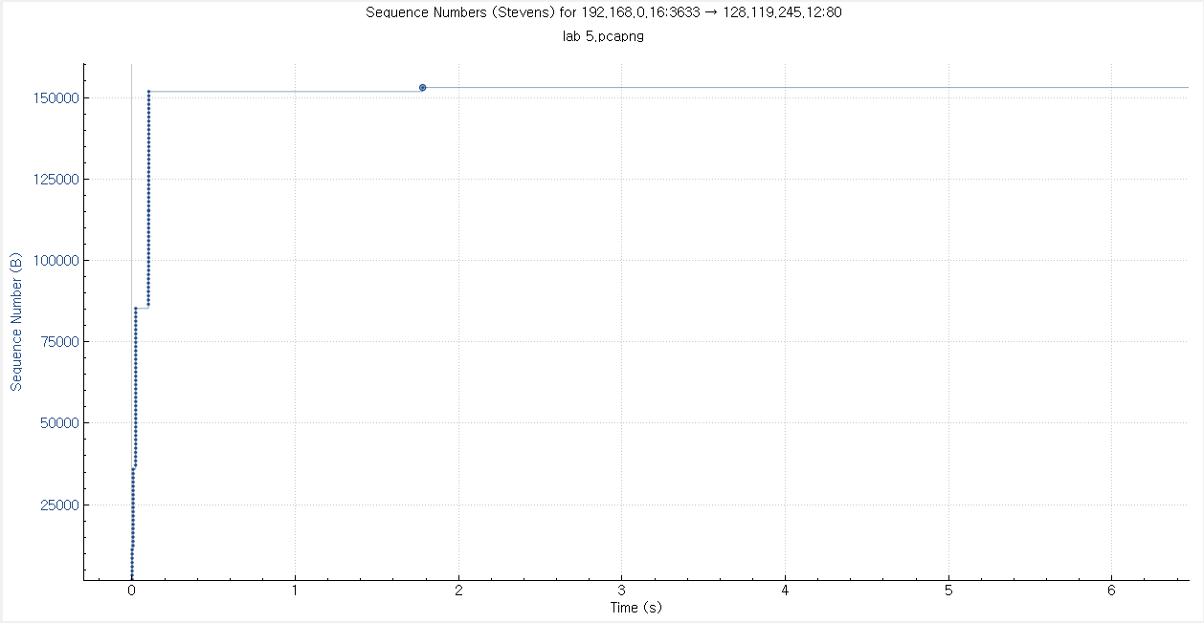
* Can you identify where TCP’s slowstart phase begins and ends, and where congestion avoidance takes over? Comment on ways in which the measured data differs from the idealized behavior of TCP that we’ve studied in the text.
Time Sequence(Stevens) graph.

Slide 36
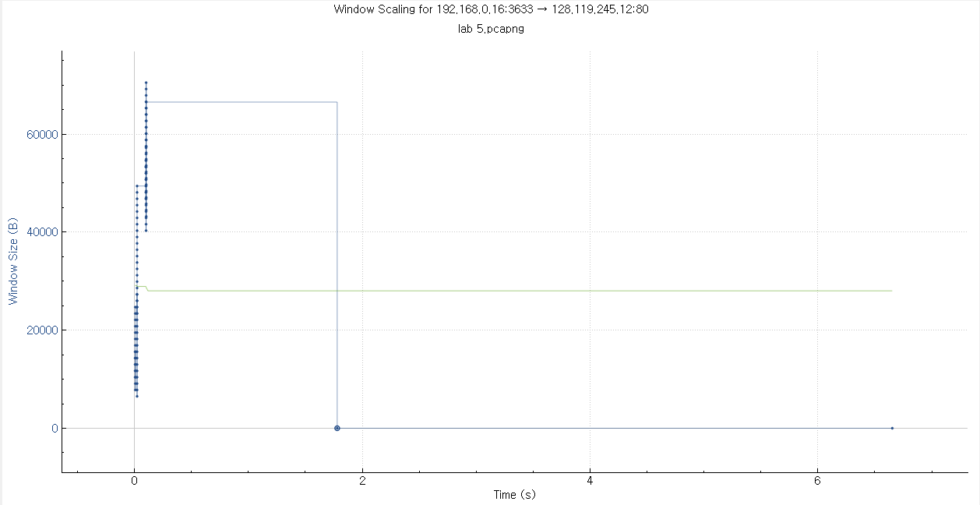
* Can you identify where TCP’s slowstart phase begins and ends, and where congestion avoidance takes over? Comment on ways in which the measured data differs from the idealized behavior of TCP that we’ve studied in the text.
다음은 Window Scaling graph.

Slide 37
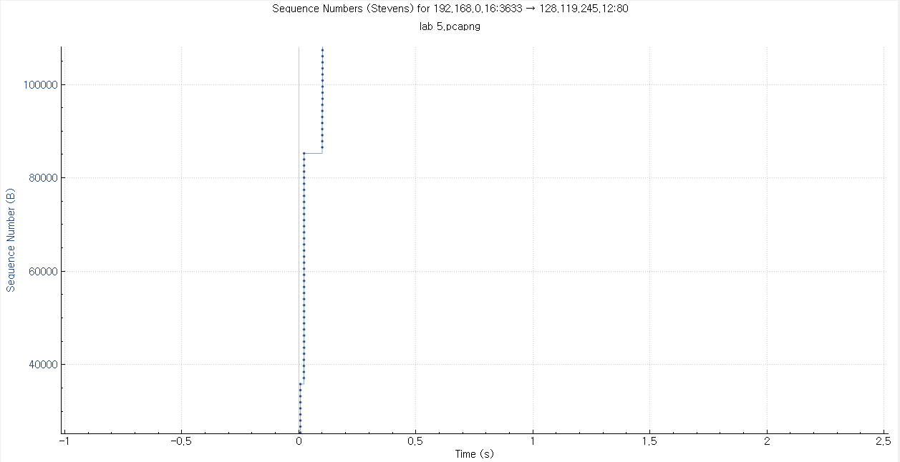
* Can you identify where TCP’s slowstart phase begins and ends, and where congestion avoidance takes over? Comment on ways in which the measured data differs from the idealized behavior of TCP that we’ve studied in the text.
다음은 Time Sequence(Stevens) 그래프를
확대한 것이다.
이 그래프에서 약 0.0초에서 약 0.5초 사이까지 중간중간 Sequence number가 잠시 동안 유지되기는 하지만 계속해서 급격한 증가추세를 이루고 있다는 것을 알 수 있습니다.
기다리는 것은 아마 ACK를 기다리면서 생긴 시간이 아닐까 예상을 합니다.
이 그래프만 본다면 TCP fast retransmission같은 현상은 일어나지 않았음을 볼 수 있습니다. 즉 아무러 error없이 정말 무탈하게 올라갔음을 볼 수 있습니다.

Slide 38
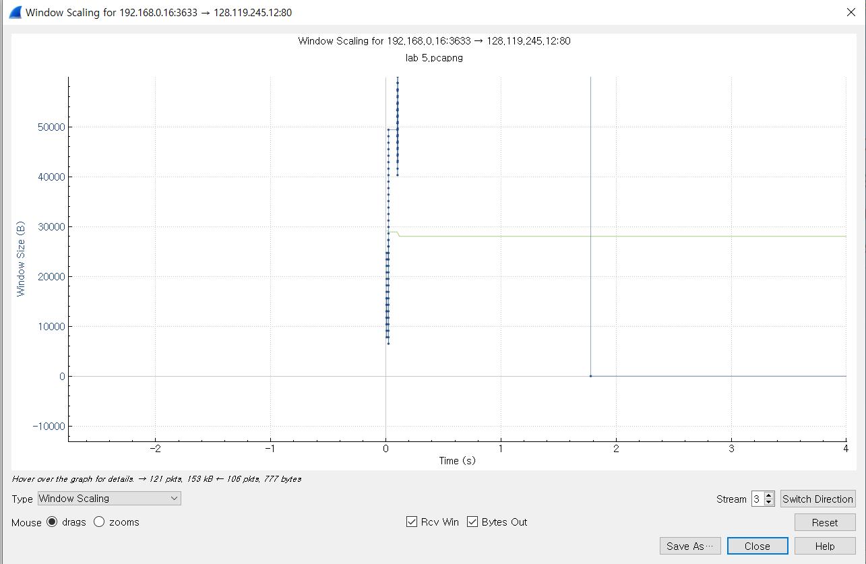
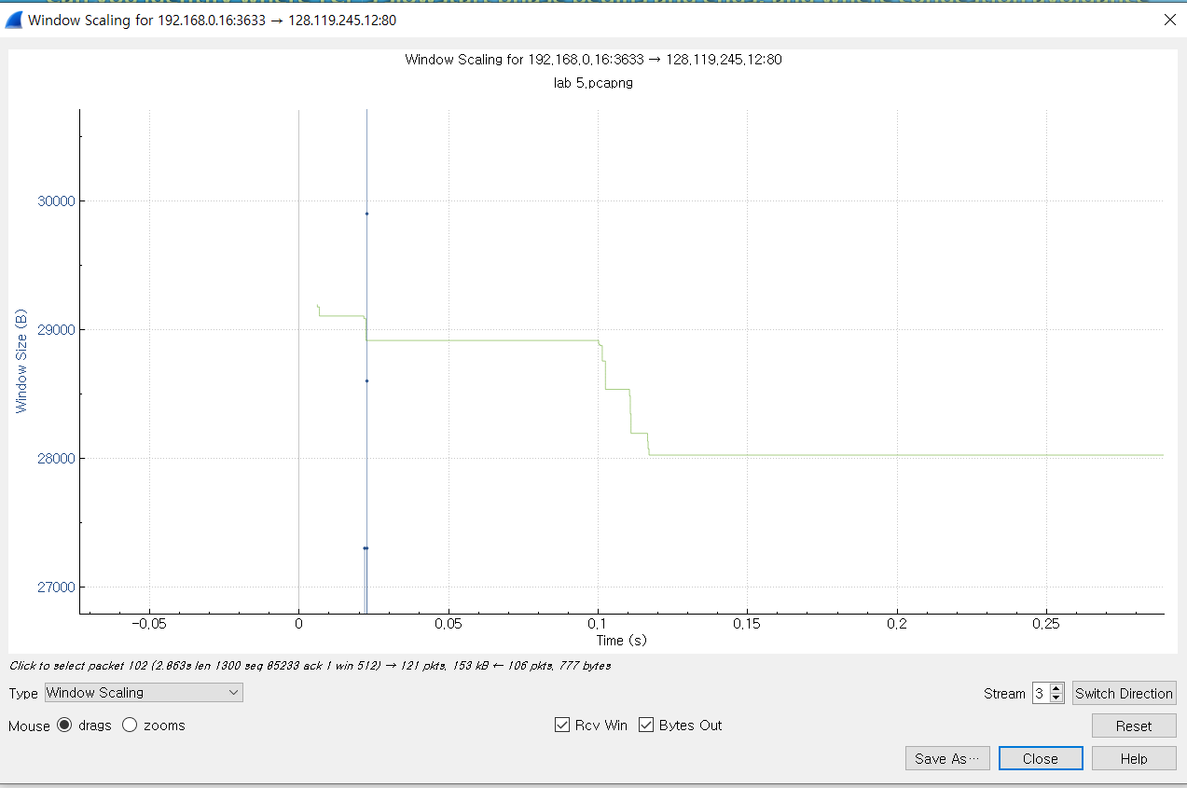
* Can you identify where TCP’s slowstart phase begins and ends, and where congestion avoidance takes over? Comment on ways in which the measured data differs from the idealized behavior of TCP that we’ve studied in the text.
다음은 Window Scaling 그래프를 확대한 것이다.
이 그래프에서 약 0.0초시작부터 0.15초 정도까지 Window Size가 어느정도 값을 유지하다가Rcv window size값 점점 작아지는 것을 볼 수 있습니다.
이는 초기의 window size를 통해 보냈던 data의 양에서 어느정도의 정당크기를 찾은 것으로 보입니다.
그 근거로서 byte out량또한 비슷한 시기에 약간 조절되면서 기하급수적으로 작아졌다 다시 급격하게 증가하는 모습을 보이고 있습니다.

Slide 39
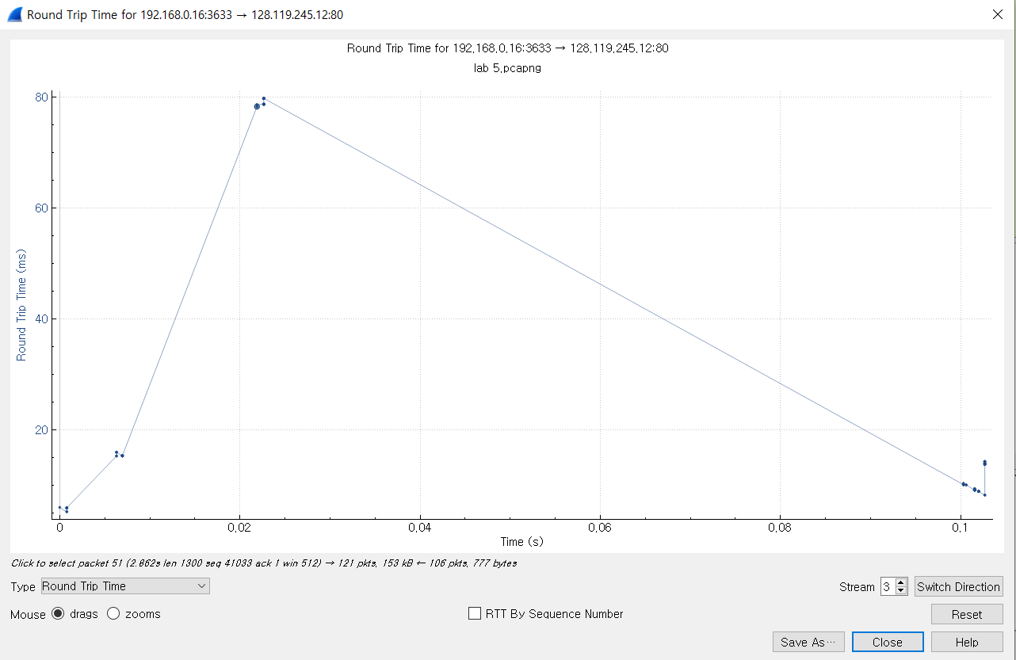
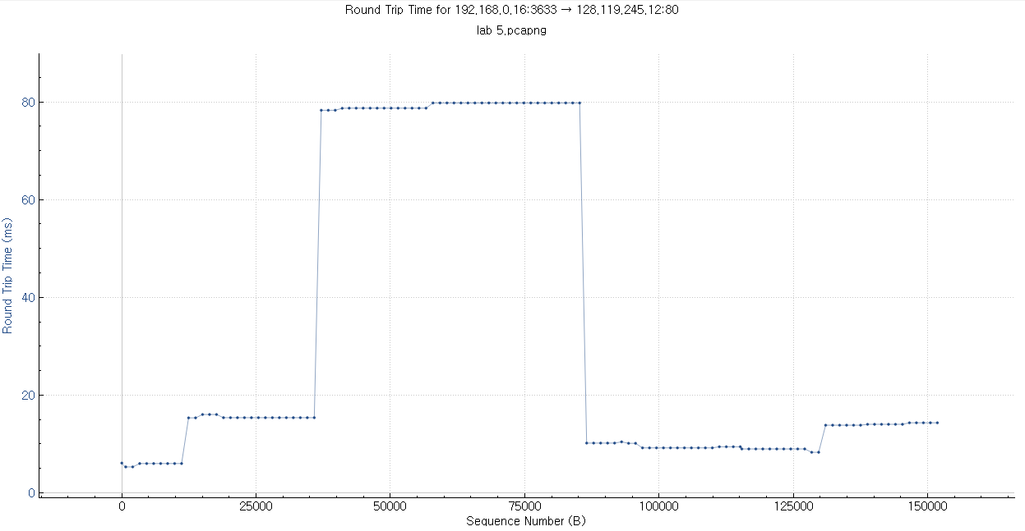
* Can you identify where TCP’s slowstart phase begins and ends, and where congestion avoidance takes over? Comment on ways in which the measured data differs from the idealized behavior of TCP that we’ve studied in the text.
다음은 RRT 그래프입니다.
이 그래프에서 앞서 window scaling에서 본 대로 0.15초가 되기 전까지 2번의 RRT의 순간적인 감소가 있었는데, 이는 window size감소, 정확히는 적당화로 인해 발생한 순간적인 byte out양의 감소에 따른 delay의 영향으로 생각합니다..
또한 그 이후 꾸준하게 올라갔다가 다시 꾸준하게 내려오는 모습을 보며 TCP fast retransmission같은 현상은 일어나지 않았음을 볼 수 있습니다.
다만 slow start라 볼 수 있는 근거는 덫붙힌 sequence number에 따른 RRT 그래프를 통해 시작의 아주 잠시동안 보내는 시간이 짧았음을 통해 아주 잠시동안 적은 양의 data를 보내 테스트했는 듯한 모습을 볼 수 있습니다.
따라서 Tahoe에 가장 가까운 모습일 수 있으나 그 속도와 시간이 가히 빨라 단정지을 수는 없다고 생각합니다. 무엇보다 아무런 error없이 정말 무탈하게 전달이 되었기 때문입니다.

